Slide 1
PREP-KC Partner Districts – 18-19 Demographics
District | Total Students | 9-12th Population | Minority Students | Economically Disadvantaged
Kansas City, KS District | 23,275 | 6,027 | 89% | 83%
Kansas City, MO District | 15,722 | 4,086 | 90% | 100%
Independence (MO) District | 15,139 | 4,238 | 44% | 68%
Center (MO) District | 2,668 | 687 | 80% | 72%
Grandview (MO) District | 4,347 | 1,249 | 80% | 78%
Hickman Mills (MO) District | 5,888 | 1,295 | 91% | 100%
Allen Village Charter (MO) | 574 | 179 | 97% | 87%
Crossroads Charter (MO) | 785 | 94 | 64% | 52%
Guadalupe Centers Charter (MO) | 1,332 | 405 | 98% | 89%
Totals | 69,730 | 18,260 | 79% | 84%

Slide 2
A Regional Approach to Improving Urban Education
PREP-KC partners with 6 districts and 3 charters that enroll 69,730 students
15 urban high schools serving over 18,000 9th-12th graders
15 urban middle schools serving almost 10,000 7th-8th graders
North
East
Platte
Buchanan
West Platte Co.
Co.
Clinton Co.
Lawson
Smithville
Kearney
Platte Co.
Excelsior
Springs
Liberty
Missouri
Park Hill
North
City
Piper-
Kansas City
Kansas City
Fort Osage
Kansas City,
KS
Bonner
Kansas City,
MO
Independence
Springs
Turner
Grain
Raytown
Blue Springs
Valley
Oak
Shawnee Mission
Grove
Desoto
Center
Hickman
Mills
Lee's Summit
Olathe
Lone Jack
Grandview
Gardner
Blue Valley
Edgerton
Antioch
Spring Hill

Slide 3
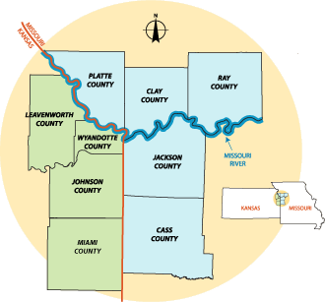
Income Data in PREP-KC Partner Districts
Median household income in the zip codes served ($43,160) are only 67% of the median household income across the 9-county region ($63,848).
40 of the 47 zip codes served by partner districts have median household incomes below the regional average.
19 of the 20 zip codes with the lowest median household incomes in the 9-county region are served by PREP-KC partner districts.

Slide 4
PREP-KC Partner Districts (Class of 2017)
In the 9-county Kansas City region, PREP-KC partners comprised:
16% of the total regional graduates
34% of the graduates of color in the region
48% of the graduates who are low-income (qualify for free or reduced lunch)

